Slide 1
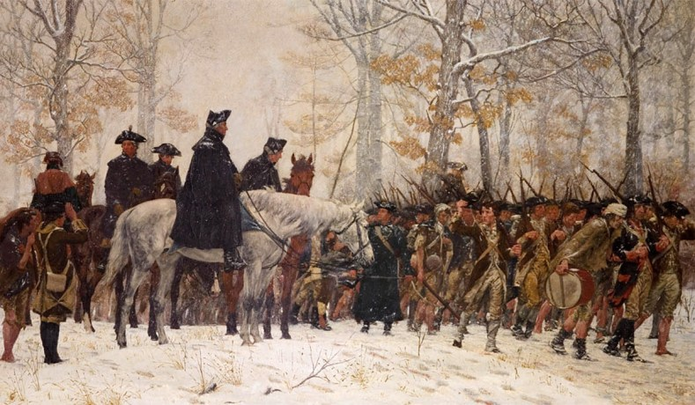
The Road to Revolution

Slide 2
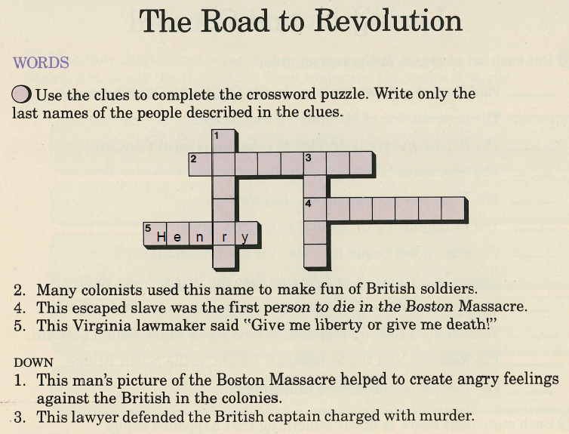
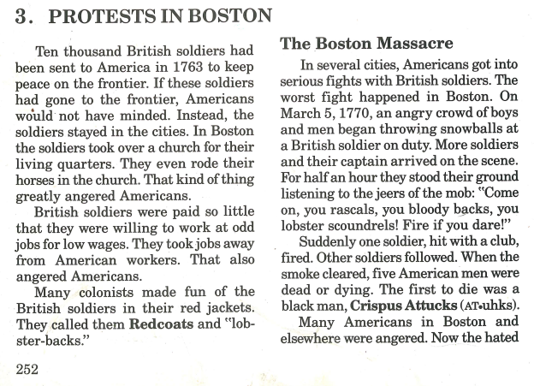
r e d c o a t s

Slide 3
r e d c o a t s
a t t u c k s

Slide 4
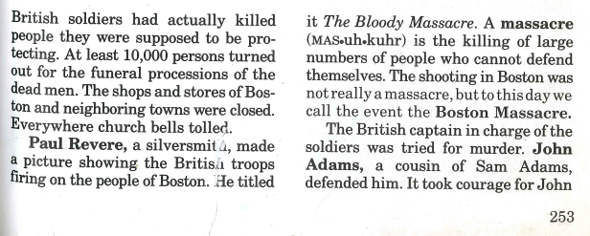
r
v e
e
r e d c o a t s
a t t u c k s

Slide 5
r
v e
e
r e d c o a t s
d
m
s
a t t u c k s

Slide 6
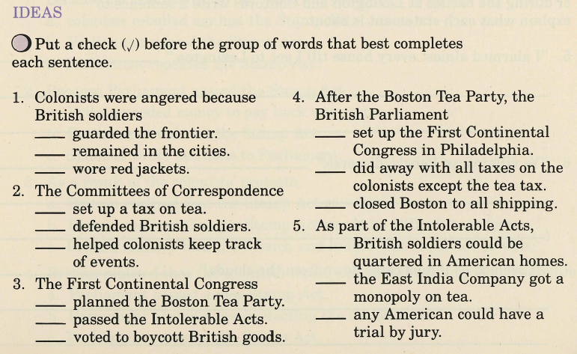
x
254

Slide 7
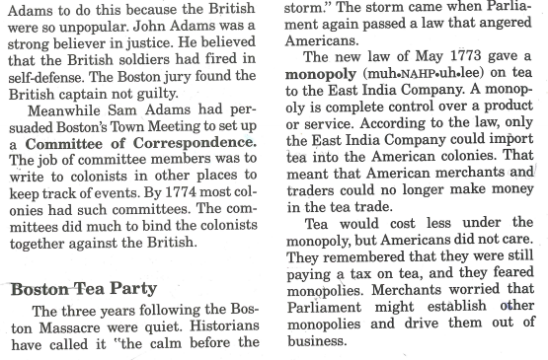
x
254

Slide 8
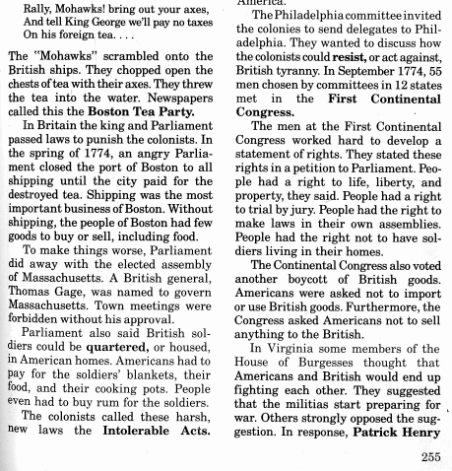
x

Slide 9
x

Slide 10
x

