Slide 1
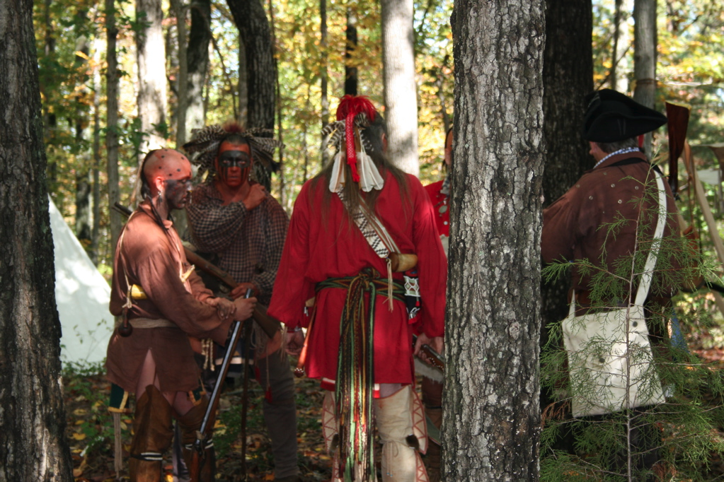
The Road to the
French & Indian War

Slide 2
The New World

Slide 3
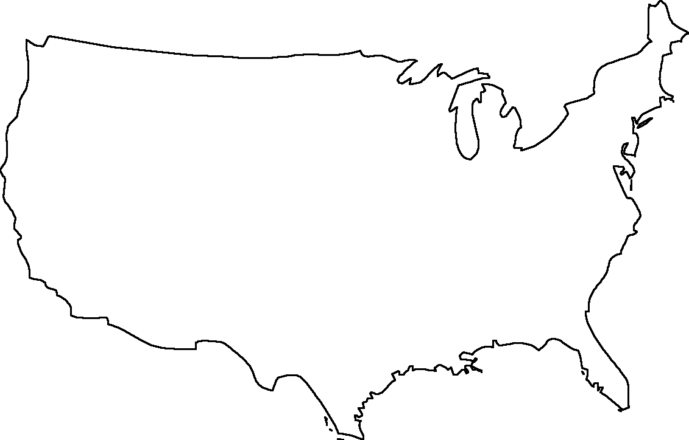

Quebec, 1608
Plymouth, 1620
Native Americans
Jamestown, 1607
Roanoke, 1585
St. Augustine, 1565

Slide 4
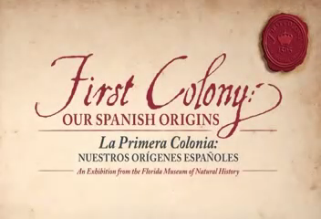
St. Augustine

Slide 5

Roanoke Colony

Slide 6
French
Native
Americans
British

Slide 7


Slide 8
